Slide 1
FinTech and InsuranceTech case studies digitally transforming Europe’s future with BigData & AI driven innovation
INFINITECH Technical Overview
Pavlos Kranas, LeanXcale Spain, pavlos@leanxcale.com

Slide 2
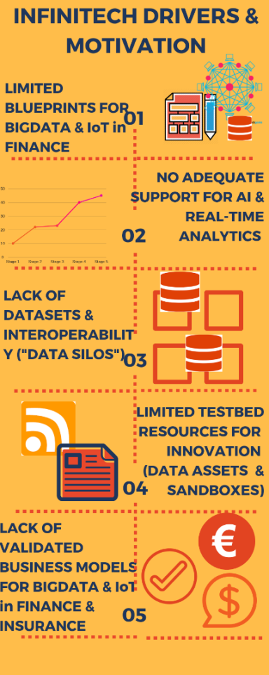
INFINITECH Drivers & Motivation
AI Architectures in their Infancy
No-Adequate support for real-time AI use cases
  E.g., detection of fraudulent transactions on the fly
Limited Data Set for Training Algorithms & Data “Silos”
Lack of testbed & experimentation resources (Data Assets & Sandboxes”)
Business Models not validated
Complex Regulatory Environment

Slide 3
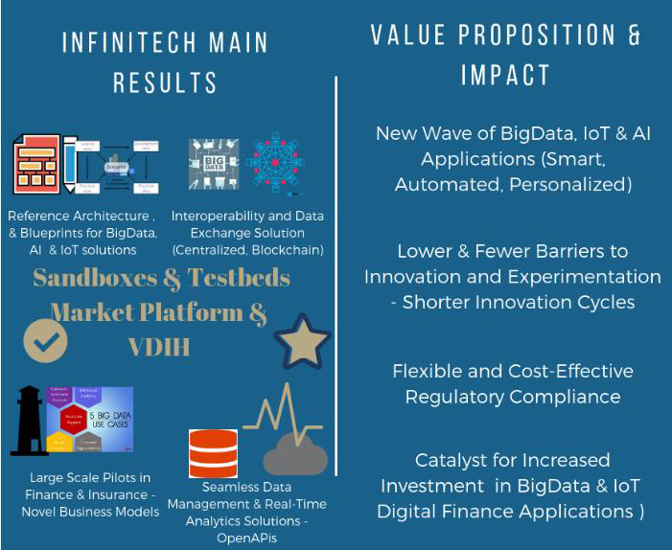
INFINITECH Results & Value Proposition

Slide 4
The INFINITECH AI Technologies

Slide 5
