Slide 1
FinTech and InsuranceTech case studies digitally transforming Europe’s future with BigData & AI driven innovation
The INFINITECH Project
Vittorio Monferrino, GFT
<vittorio.monferrino@gft.com>

Slide 2
Background
Historically, the financial and insurance services sectors are “conservative” (resistant to digital transformation and technology disruptions)
Digital Technologies are rapidly transforming the financial and insurance services industry
The vast majority of digital transformation applications for the finance and insurance sectors are data-intensive and leverage technologies on fragmented data sources
Endless quest for cost-effective applications exploiting Big Data also coming from IoT and Data Lakes

Slide 3
H2020 Program Grant
Innovation Action
Project Budget: 21.080.482 €
EC Grant: 15.870.480 €
Timeframe: 01/10/2019-31/12/2022
47 Participants (Industry, Academia, FinTechs)
Tailored IoT & BigData Sandboxes and Testbeds for Smart, Autonomous and Personalized Services in the European Finance and Insurance Services Ecosystem

Slide 4
INFINITECH Vision
Innovation
Market
Execution
Novel Technologies&Tools
for digital Finance Innovation & Experimentation based on IoT/BigData
Disruptive Financial Services Solutions
Validate Resources, Platforms and Processes
Provide IoT & BigData Platforms
customized for Digital Finance
Novel BigData/IoT/AI technologies leveraged on fragmented data sources
Innovative Industry-Driven Use Cases, applied in several fields
In terms of integration with banking & finance systems
Flexible RA to map and deploy pilots, flexibility, interoperability
Models for Business Validation & Commercialization, Marketplace, VDIH
Testbeds, Sandboxes, on-cloud and on-prem, common components

Slide 5
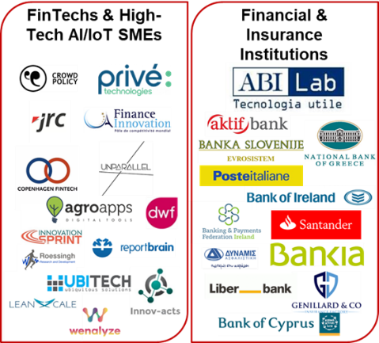
INFINITECH Team
Innovation
Market
Execution

Slide 6
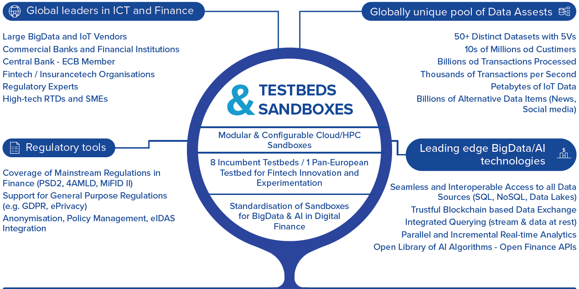
Project Overview
Innovation
Flexible Reference Architecture to map the 15 Pilots

Slide 7
The INFINITECH Pilots (Finance)
Market
Personalized Retail and Investment Banking Services
Predictive Financial Crime and Fraud Detection
KYC & Customer-centric Data Analytics
Personalized Portfolio Management & “Democratization” of Investment Banking
Smart & Personalized Pocket Assistant for PFM
Operation Whitetail – Avoiding Financial Crime
Personalized Closed-Loop Investment Portfolio Management for Retail Customers
Platform for Anti Money Laundering Supervision
Analyzing Blockchain Transaction Graphs for Fraudulent Activities
Real-time cybersecurity analytics on Financial Transactions’ BigData
Smart, Reliable and Accurate Risk Assessment
Invoices Processing Platform for a more Sustainable Banking Industry
Real-time Risk Assessment in Investment Banking
BFM tools delivering a Smart Business Advise

Slide 8
The INFINITECH Pilots (Insurance)
Market
Personalized Usage-Based Insurance Pilots
Configurable and Personalized Insurance Products for SMEs and Agro-Insurance
Personalized insurance products based on IoT connected vehicles
Real World Data for Novel Health-Insurance products
Alternative/automated insurance risk selection - product recommendation for SME
Big Data and IoT for the Agricultural Insurance Industry

Slide 9
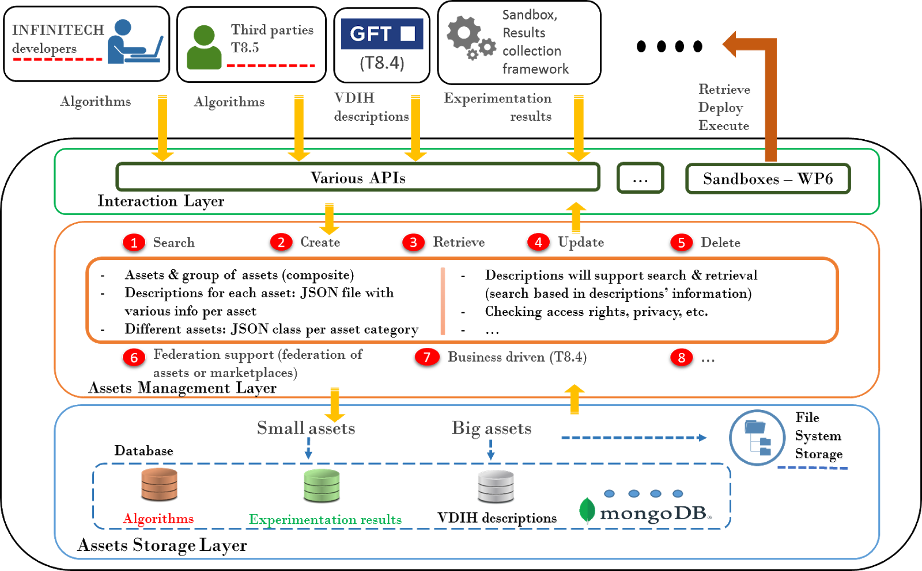
Marketplace, VDIH and ISA
Market
ISA is the main vehicle for engaging relevant stakeholders
Stakeholder ecosystem
Structured communication
Privileged access to information
Collaboration with R&I
Newsletter with focused information

Slide 10
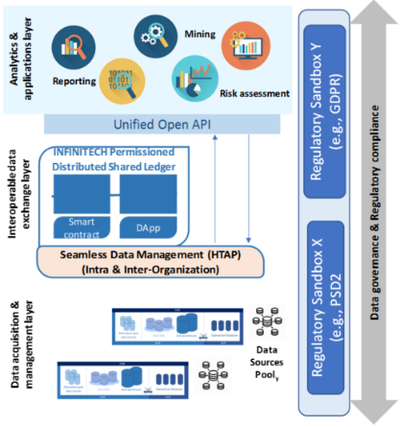
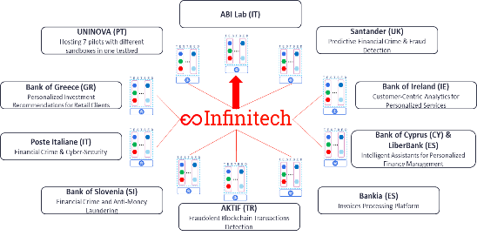
INFINITECH Testbeds & Sandboxes
Execution
INFINTECH technological building blocks
Open API
Data assets
Regulatory Compliance Tools
ML/DL algorithms

Slide 11
Thank you for the attention
Vittorio Monferrino vittorio.monferrino@gft.com
14th May 2020, BDV PPP webinars

