Slide 1
Seamless Analytical Framework
Pavlos Kranas
LeanXcale
pavlos@leanxcale.com

Slide 2
Seamless Analytical Framework
Modern enterprises use
Operational databases for OLTP load
Key-Value for IoT data
Data warehouses for data analytics
Datalakes
etc ...
Need polyglot capabilities

Slide 3
Seamless Analytical Framework
Nowadays: Data Federation using Spark

Slide 4
Seamless Analytical Framework
Nowadays: Data Federation using Spark
BUT:
Can be very resource consuming
Cannot exploit the specific capabilities of each different datastore

Slide 5
Seamless Analytical Framework – User Story
Data ingestion in operational datastore (LeanXcale)
Old data becomes historical, with no modifications
Data Warehouse to perform analytics on big data volumes
Distribution of datasets is problematic
Data to be retrieved from both stores
To be merged in the application level
Data consistency considerations when moving datasets

Slide 6
Seamless Analytical Framework - Solution
Seamless Analytical Framework
Federate data coming from two different datastores:
HTAP Relational LXS Datastore
IBM Object store
sharing the SAME dataset
Single (black box) component that
consists of two datastores
exploits unique characteristics of each one
transparently from the user
does not compromise some requirements for the benefits of others

Slide 7
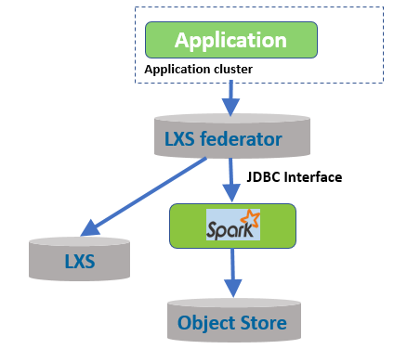
Query Federation

Slide 8
Query path
SELECT vessel_code, datetime, longitude, latitude, wind_speed
FROM danaos
WHERE wind_speed > 30
Seamless Component
LXS Federator at: ‘2018-01-01'

Slide 9
Query path
SELECT vessel_code, datetime, longitude, latitude, wind_speed
FROM danaos
WHERE wind_speed > 30
Seamless Component
LXS Federator at: ‘2018-01-01'
LXS Federator
LXS DB
WHERE wind_speed > 30
AND date > ‘2018-01-01’

Slide 10
Query path
SELECT vessel_code, datetime, longitude, latitude, wind_speed
FROM danaos
WHERE wind_speed > 30
Seamless Component
LXS Federator
WHERE wind_speed > 30
AND date <= ‘2018-01-01’
LXS DB
Spark JDBC Thrift Connector
with
Data Skipping
WHERE wind_speed > 30
AND date > ‘2018-01-01’
Object Storage

Slide 11
Supported Operations
Currently supports
Full Scan
Ordered Scan
LIMIT
Aggregations
Group By Aggregations
Ordered Group By Aggregations
Does not yet support
JOIN on fragmented data tables

Slide 12
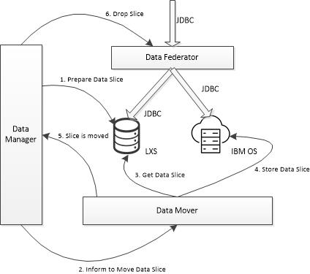
Data Movement High Level

Slide 13
Data Movement High Level
Prepare Data Slice – Data Manager informs LXS to move data slice to a new data region, so that it can easily drop it later
1. Prepare Data Slice

Slide 14
Data Movement High Level
Inform to Move Data Slice – Data Manager informs the Data Mover that it can start the movement process, sending the SQL statement to grab the data slice from LXS
2. Inform to Move Data Slice

Slide 15
Data Movement High Level
Get Data Slice – Upon receiving a message from the RabbitMQ the data mover fetches the data slice from LXS via JDBC
3. Get Data Slice

Slide 16
Data Movement High Level
Store Data Slice – Data Mover layout the data, build data skipping indexes and stores the data to Object Storage
4. Store Data Slice

Slide 17
Data Movement High Level
Slice is moved – After data is persisted in Object Store, an ACK is sent to the Data Manager which then informs the federator to adjust the split point and drop the slice from LXS
5. Slice is Moved

Slide 18
Data Movement High Level
Drop Slice – Federator forwards the split point and requests LXS to drop the slice
6. Drop Slice

Slide 19
Seamless Analytical Framework
Thank you!!!

Slide 20
Federator Ensures Data Consistency
2018-01-01
Federator
IBM COS
LXS
2018-01-01

Slide 21
Federator Ensures Data Consistency
2018-01-01
Federator
IBM COS
LXS
2018-01-01
2018-02-01

Slide 22
Federator Ensures Data Consistency
2018-02-01
2018-01-01
Federator
IBM COS
LXS
2018-01-01
2018-02-01

Slide 23
Federator Ensures Data Consistency
2018-02-01
2018-01-01
Federator
IBM COS
LXS
2018-01-01
2018-02-01

Slide 24
Federator Ensures Data Consistency
2018-02-01
2018-01-01
Federator
IBM COS
LXS
2018-01-01
2018-02-01

Slide 25
Federator Ensures Data Consistency
2018-02-01
Federator
IBM COS
LXS
2018-02-01

Slide 26
Next Steps
Support of the JOIN operation on split tables between the stores
Both Stores natively support JOIN operations
Query Federator can push down the operation and merge results
Strategies to take into account data locality to reduce amount of data to be sent
JOIN can be translated as the union of 4 separate JOINS
Bind Join can be considered for optimize the execution

